Slide 1

Data Exploration
Rayid Ghani and Kit Rodolfa

Slide 2
Short Quiz

Slide 3



Where to look for what
Content schedule, slides, etc.
Assignments description and submission
Communication announcements, discussions, questions, etc.

Slide 4
Things to remember
Make sure and check that you can access your project data today
Wednesday session tomorrow: time for group work and check-ins
Wednesday sessions are required class sessions
Be sure to attend your assigned session from this point forward
Due this week:
Watch Analytic Formulation and Baselines Lecture Video (for Thursday)
Reading for Thursday
ACS Data loading assignment on canvas (due Friday)
Make sure to read project proposal assignment on canvas (due next Friday)

Slide 5
Plan for today
Data exploration overview and helpful tips
Time to meet and coordinate with your groups (~30 minutes at the end of class)

Slide 6
Scope
Data
Exploration
Modeling
Get Data
Store Data
Link Data
Rows
Features
Labels
Model Selection
Train-Test Splits
Performance Metrics
Model Interpretation
Entities
temporal
Spatial
…
Models
Dealing with Bias and Fairness
Field Trial Design
Deployment
Monitoring
Goals, Actions, Data, Analysis, Ethics

Slide 7
Why is data exploration important?
Sanity Check the data you were given
Understanding the problem and domain
Problem Formulation
Debugging
Feature Generation/Selection
Interpretation of results

Slide 8
Some tips for exploring your project data
Tables: identify the database tables that are most relevant to your problem
Entities: How can you identify the primary entities from your project? What are some basic/relevant characteristics about them? How have those changed over time?
Fields: Most projects have a lot of different data fields, but don’t feel like your initial exploration needs to understand everything
Label: Think about how you might define your label? What can you say about its distribution and how it’s changed over time?
Based on what you know of the context, what information would you expect to be important in modeling? Is this available? How well does it correlate with your label?

Slide 9
Typical data exploration tasks
Distributions of different variables
Correlations between variables – correlation matrix and turn it into a heatmap
Changes and trends over time – how does the data and the entities in the data change over time?
Missing values – are there lots of missing values? Is there any pattern there? How/why are they missing?
Outliers – this can be done using clustering but also by plotting distributions.
Labels/Outcomes – distribution and patterns
Cross-tabs (if you’re looking at multiple classes/labels), describing how the positive and negative classes are different without doing any machine learning.

Slide 10
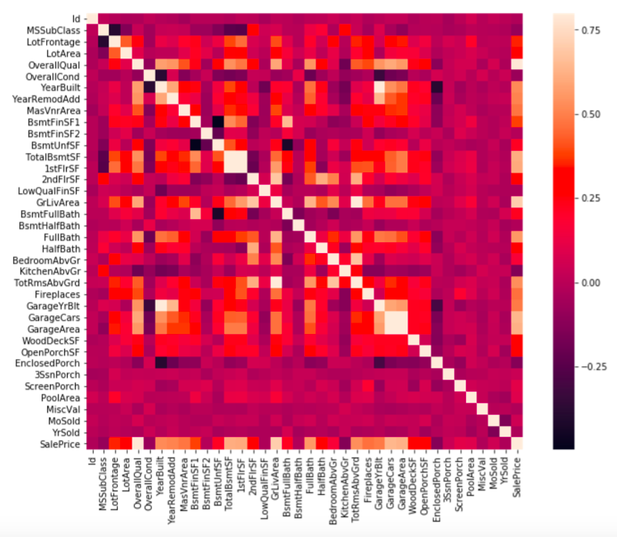

Slide 11
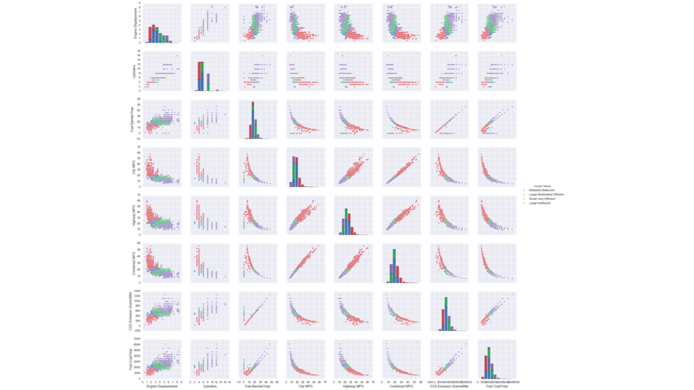

Slide 12
Tools
SQL (directly and through python – psycopg2)
Python (matplotlib, seaborn, altair,...)
Pandas(if you have to)
Tableau

Slide 13
Simple task for data exploration
Write a SQL query that takes a “person id” (e.g., student, voter, facility, entity, etc) and gives you everything you know about that person.
Add a date parameter to it to give you everything about that entity up to that date

Slide 14
Things to remember
Make sure and check that you can access your project data today
Wednesday session tomorrow: time for group work and check-ins
Wednesday sessions are required class sessions
Be sure to attend your assigned session from this point forward
Due this week:
Watch Analytic Formulation and Baselines Lecture Video (for Thursday)
Reading for Thursday
ACS Data loading assignment on canvas (due Friday)
Make sure to read project proposal assignment on canvas (due next Friday)

Slide 15
Project Team Meeting / Coordination

Slide 16
What do we want you to use this time for?
Get to know each other
Discuss how you’re going to work together
Schedule times to work on the project proposal over the next week and a half
Discuss project direction and ideas

